Slide 1
Landfill Hackathon Presentation
By: Jack BL, Gian, Olivia, and Gabe

Slide 2
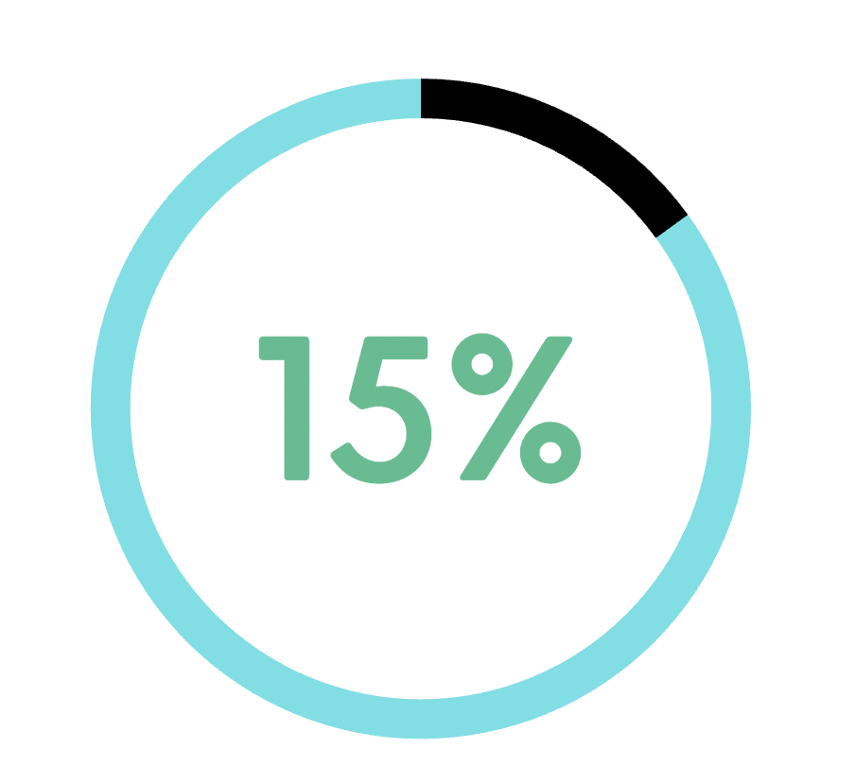
Problem
E-waste is harmful to humans, animals, the land, and the sea.
As of now, merely 15-20 percent of all e-waste is recycled.
The value of this e-waste is conservatively estimated at $57 billion US dollars
53.6
Million
Notes:
E- waste is electronic waste that is thrown out and usually is put into landfills. E-waste has been proven to poison soil in landfills and when it is exposed to heat, toxic chemicals are released that damage the atmosphere. This also affects the quality of the air and these chemicals can go downstream and affect the ocean and sea life. Currently only 15-20 percent of e-waste is recycled. In 2019, 53.6 million metric tons of e-waste was produced worldwide. This weighs as much as 350 Queen Mary 2 cruise ships!

Slide 3
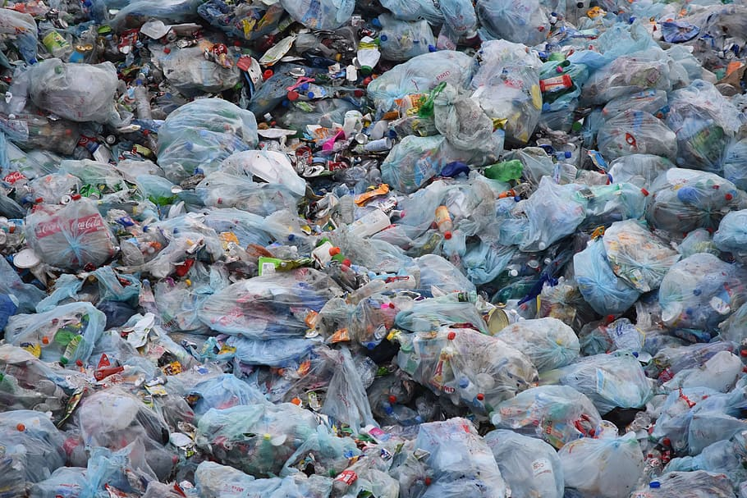
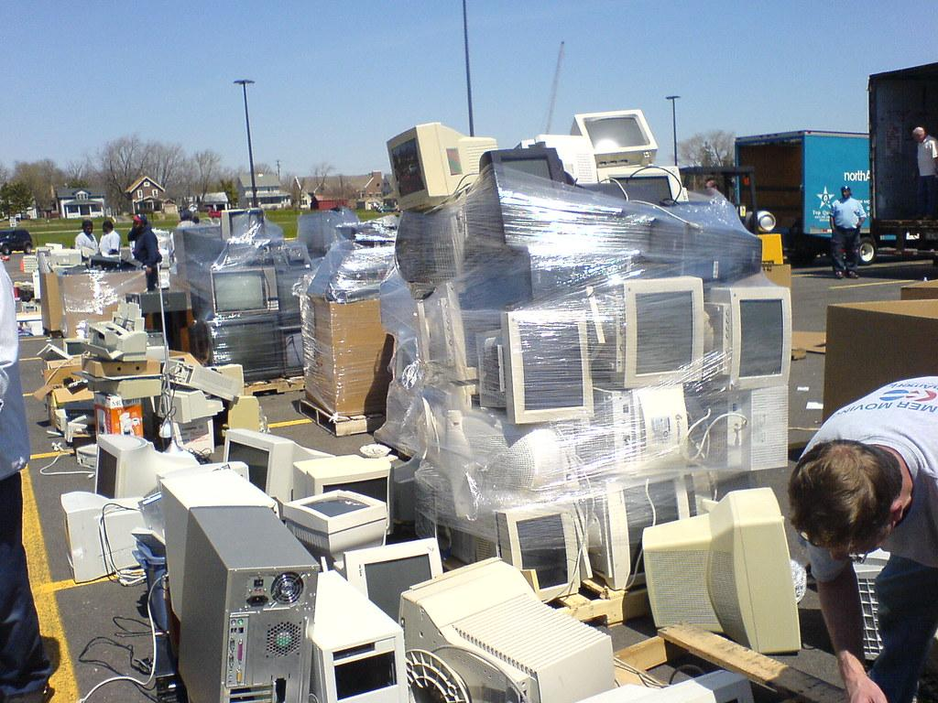
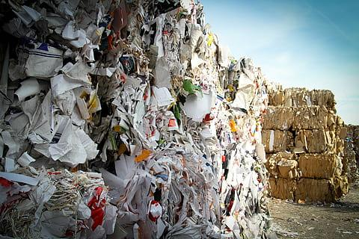
Delhi, India
E waste is is harming children
Toxins that are found in landfills are causing long term damage to children as young as ten years old
Notes:
Electronic waste is not only detrimental to the environment, it is also harmful to people, especially children. In Delhi, India children from aged 10-14 are being employed to manually sort through waste in landfills. Children is one of the most common age group that is employed to work at these waste sites. They are then being exposed to the toxic waste produced, and are suffering from the effects of these toxins, including respiratory diseases and high concentrations of lead in their blood, which cause neurological, physiological, and developmental issues.

Slide 4
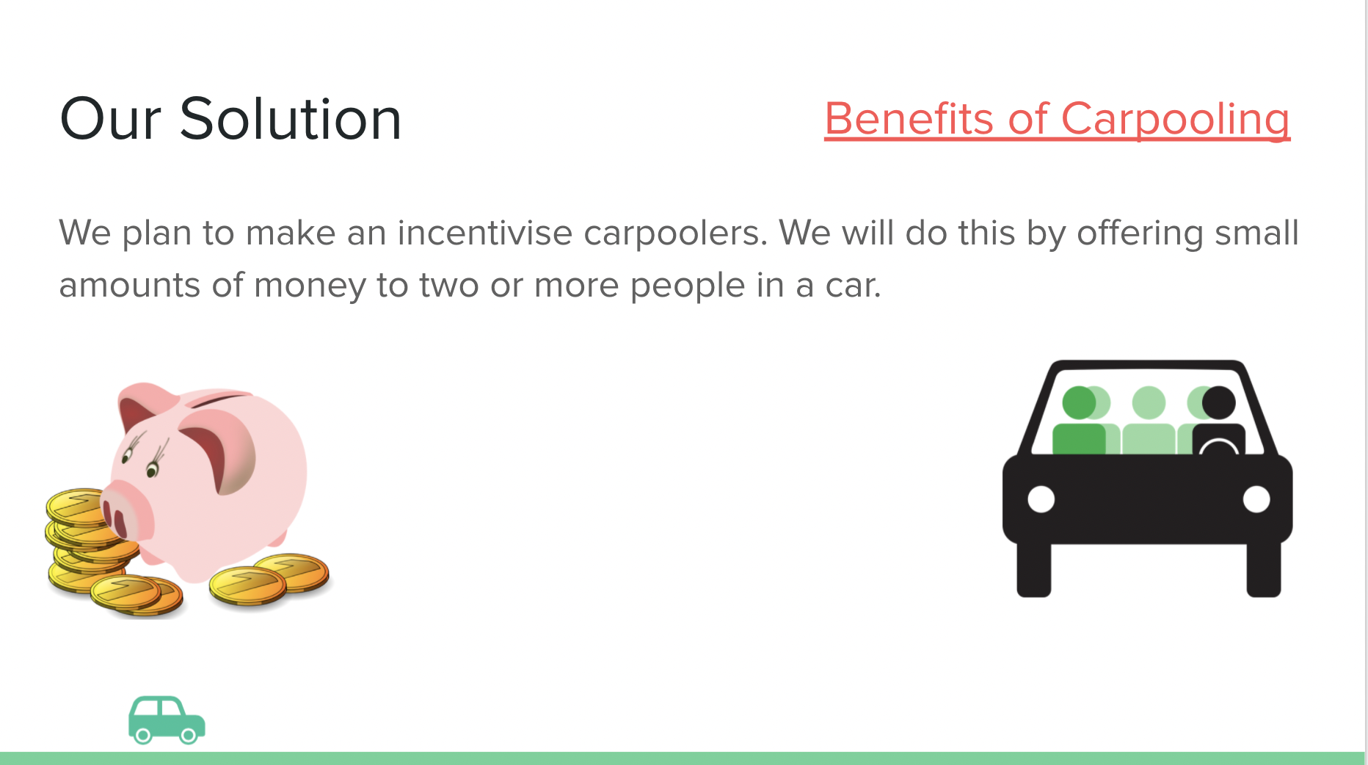
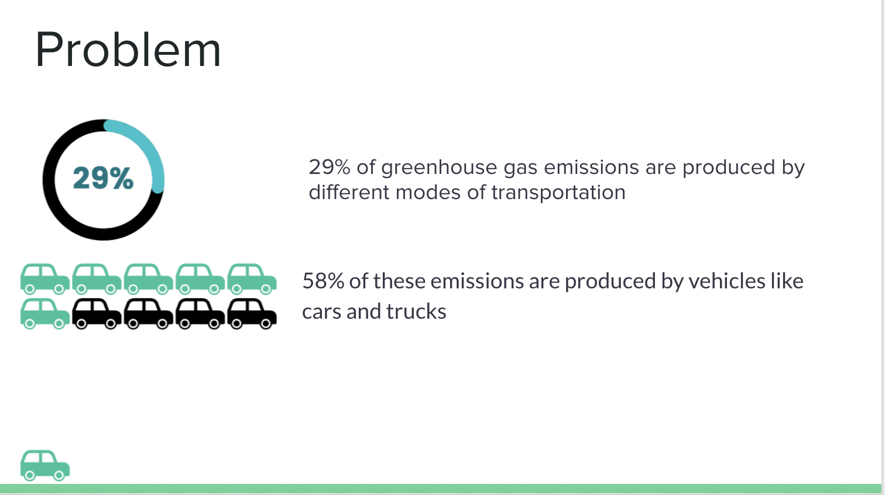
Past Project Ideas
Notes:
During our creation of our project, we have
had to do a lot of pivoting. We had many
different project ideas that we pursued all
of which did not fully work. We tried to do a carpooling idea that tracked the
number of people in a car. In order to do this, we would have needed an infrared
sensor. With this project, our 50(ish) algorithm, we got it partially working. In the
future, in order to get it fully, we would use an x-ray to detect devices.

Slide 5


Creativity and Solution
Our solution is to set up cameras looking at landfills
and have them scan the area looking for e-waste
This is creative because it is taking work that would have to
be done by humans in non sanitary environments and letting
a machine do it
This will also be self sufficient because we will
sell the devices we find
Notes:
Our solution took a lot of trial and error to come to. We had to switch ideas in the middle of the hackathon, but working together quickly and carefully we were able to bounce back. We decided one of the ways to help decrease the amount of e-waste in landfills was to train algorithms to recognize e-waste so that they can be recycled and reused. Instead of having children sorting through these waste sites and get exposed to these toxins, a drone will fly over the landfills to locate e-waste so that workers with proper protection can retrieve it.

Slide 6
Demo
We used real life images in order to collect our data
Notes:
In creating our solution, we collected our own data. We used phones and mixed them in with other everyday objects that could be thrown away.
We created our own mini landfill, so that we could collect data of the electronics in the landfills. Our algorithm does fall short in a few ways: it gets confused with many different colors in the background, and sometimes it does not detect the electronics perfectly.

Slide 7
Impact at a Scale
Less toxins released into our environment
Healthier people and environment
More jobs
Less demand for rare earth metals
Lower costs on electronics for the consumer
Helps ease the global computer chip shortage
Notes:
With the help of the UN, we will identify the regions with the most e-waste and deploy our first devices there. This will have the benefit of reducing the amount of toxic materials that is damaging the environment, leading to healthy people and environment. This will lead to jobs for many people while also keeping them safe by providing protective material.

Slide 8
Cost of Solution
For one unit, we estimate the price at about $20,000/year (NOT INCLUDING PROFITS FROM SELLING DEVICES AND ITEMS AT WHOLESALE).
Breakdown:
Raspberry Pi entire contraption - $150/year
Raspberry Pi case - $30
Electricity - $30/month
Drone - $3,000
Labor - $1200/month
Protective material - $100/ person
Estimated 2.42 million US$ worth of e-waste are at each given landfill in the US.
Notes:
4.2 percent of all trash is e-waste. On average, 5,863,200 tons of e-waste are sent to a landfill. About 2.4 million US$ worth of e-waste are at each given landfill in the US. If all of this ewaste was collected, we would be able to make a large profit.

Slide 9
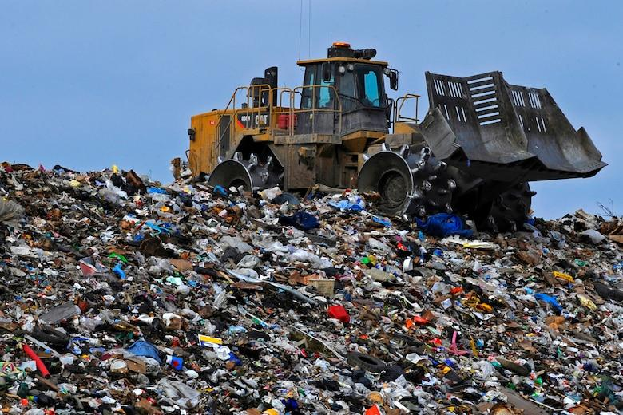
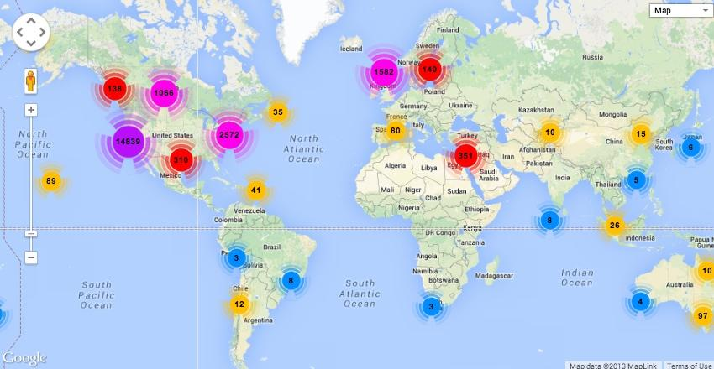
Future Plans
Notes:
If we were to continue this project, we would attempt to develop our own microprocessor made of the very electronic waste we would have reclaimed. Over time, we would further train the algorithm to identify e-waste and equip it with thermal, sonar, and metal detectors.

Slide 10
Bibliography
“E-Waste & Children: How It Is Harming Future Generations.” Two Sides North America, 31 Jan. 2014, twosidesna.org/US/E-Waste-Children-How-It-Is-Harming-Future-Generations/.
Forti, Vanessa. “The Global E-Waste Monitor 2020 .” Ewaste Monitor, UNITAR, ewastemonitor.info/.

